Slide 1
Family In Christ Program
Session 5 – Tips to Raise our Children In Western Society
Sunday, April 7, 2013

Slide 2
Introduction
We are all created by God, for God
Parenthood is a gift from God
Children lent to us by God
To raise them to do His will
He raises them; our job is to put them in His hands
We will be held accountable before God for their upbringing
The parable of the talents
Notes:
Ann
Purpose Driven Life

Slide 3
Introduction (cont’d)
What is our final job, final objective?
Raise them to be successful, or
Guide them to Heaven?
What is the devils final objective?
Separate us (and our kids) from Christ
Notes:
Emad
Some think conflict between these two

Slide 4
Start with the End in Mind
Driving a car: have to know where you want to go in order to get there
Notes:
Emad

Slide 5
”As for me and my house, we will serve The Lord” Josh 24:15 أَمَّا أَنَا وَبَيْتِي فَنَعْبُدُ الرَّبَّ ﻳﺸﻮﻉ15:24
3 mandates:
Guide them to Christ
Love them
Build their confidence
Notes:
Emad

Slide 6
God is in Control
They are His children before they ever were ours
Psalm 139
We do our best, and God does the rest
His part is enormous
Our part is very small, but necessary
Fisherman in boat
Feeding the 5 000
Even if we make mistakes, He is good and loving to cover them and protect our children
Thanksgiving Prayer: for You have covered us
Notes:
Ann

Slide 7
What do these God-Loving People Have in Common?
God’s people:
Moses
King David
Daniel
St. George
St. Abanoub
Mother Theresa
Moses!!! Cut that out and take your bath!!!
They Aren’t Born Saints...
Notes:
Emad

Slide 8
So What About Raising Our Kids in Canada?
Notes:
Emad

Slide 9
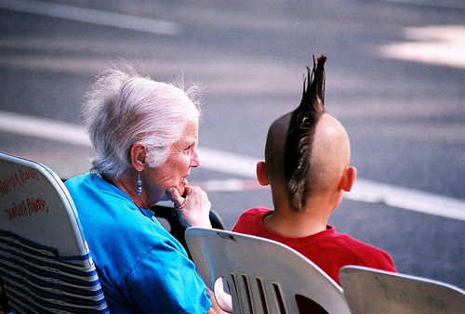
Is There a Culture Gap?
Generation gap exists everywhere
Coming to Canada adds a culture gap
Ask yourself some questions:
Why would kids want to be like Canadians?
Why would kids want to not learn/speak Arabic?
Notes:
Emad
Some parents may experience their kids desire to disassociate
Don’t resent that, but realign them

Slide 10
2 Extremes
Strict
Very controlling
Don’t allow anything
Uses physical discipline
Laissez-faire
Everything is ok
No real rules or limits
Strict
Laissez-faire
Balanced approach best
Immerse them in love
Implement strong discipline
Pick your battles
Balanced Approach
Notes:
Emad

Slide 11
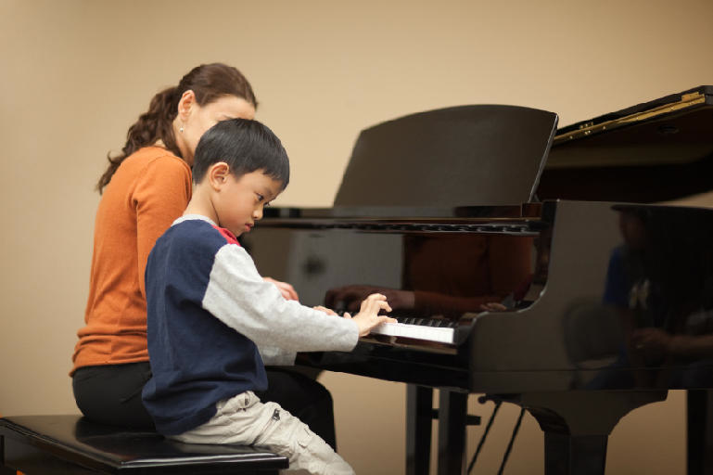
Train Them Up Early
Proverbs 22:6 ”Train up a child in the way he should go, and when he is old he will not depart from it.” دَرِّبِ الْوَلَدَ بِمُقْتَضَى مَوَاهِبِهِ وَطَبِيعَتِهِ، فَمَتَى شَاخَ لاَ يَمِيلُ عَنْهَا.
We will reap what we sow in our children
Children learn better at a younger age
Ex: languages best learned by age 5
Notes:
Ann

Slide 12
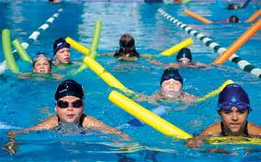
Train Them Up Early (cont’d)
The earlier we expose them to a Godly life, the easier it will be for them to accept it and to return to it should they stray
When it comes to spiritual exercises, we say, “Haram, they’re still young”
Willing to pressure them re school, sports, music
P.K. Suban and his dad
Notes:
Ann

Slide 13
Train Them Up Early (cont’d)
Take time to set them up psychologically:
Fasting
Praying
Giving
Bible reading
Spending Quiet Time with God should be as much a part of their everyday living as school
Church Liturgies, Vespers, Tasbeha, Feasts
Visits of Bishops
Serving
Notes:
Ann

Slide 14
Attitude is Key
Our expectations often frame our realities
Terrible Two’s vs Terrific Two’s
Nightmare Teenage Years
It doesn’t have to be a nightmare - if you prepare yourself and your child properly
Notes:
Emad

Slide 15
Lead By Example
Pulling vs pushing (leading vs ordering)
Lead by being in the front vs. shoving them from behind
Comment: "I stress my kids because I don't want them to have my flaws"
They will learn more from our praying for change in ourselves, from our repenting, than from our stressing them to not do the same (this may create other problems in the kids)
“How you act screams so loud, I can't hear what you are saying”
St. Francis of Assissi
Anba Maximous bishop of Banha: “Kids are raised as you behave, not as you want”
Notes:
Emad
Anba Maximous bishop of Banha: “Kids are raised as you behave, not as you want” (Bassem Necola)
parents that overreact because they were embarrassed from their kids behavior (hit Abouna's kid, swore at a servant, danced in front of the altar,

Slide 16
Lead By Example (cont’d)
Children are very intelligent and will pick up on what is a family priority more by what we do than what we say
If they see us praying, doing our Quiet Time, fasting properly, they will understand that this is important
If I tell them to go up to pray at bedtime, but I don’t myself, how serious do you think their prayers will be?
Notes:
Emad

Slide 17
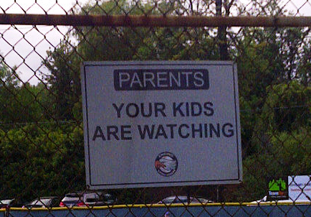
Lead By Example (cont’d)
How I behave with them is how they’ll behave with me
Do I listen to them? Do I treat them with respect? Do I respect myself and my spouse? Do I shout often?
How they watch me behave determines how they respect me when it matters:
Parents behave all nice in front of people, but when alone with their kids, they are aggressive
Parents that overreact because they were embarrassed by their kids’ behavior
You can’t fake it
Story of father asking for help with kid
Notes:
Emad

Slide 18
My Spiritual Life
We are kidding ourselves if we think we can raise Godly children without first trying to be Godly people ourselves
Spend time on my relationship with God
We tell Abouna to relax re my fasting, etc
But that’s what’s needed to protect me and my kids
The best thing we can do for our kids is pray
St. Monica
The Power of Prayer books
Notes:
Ann

Slide 19
Dad’s Role
We underestimate importance of the father in raising kids
We expect the mom to raise the kids
But dad impacts their character
By his behaviour
By his involvement when he is home
By being involved
Father is the head of the family, the priest of the family church
Movie Courageous
Notes:
Ann
How he helps, how he rushes to serve, how he balances between serving and letting them serve, how they use money.

Slide 20
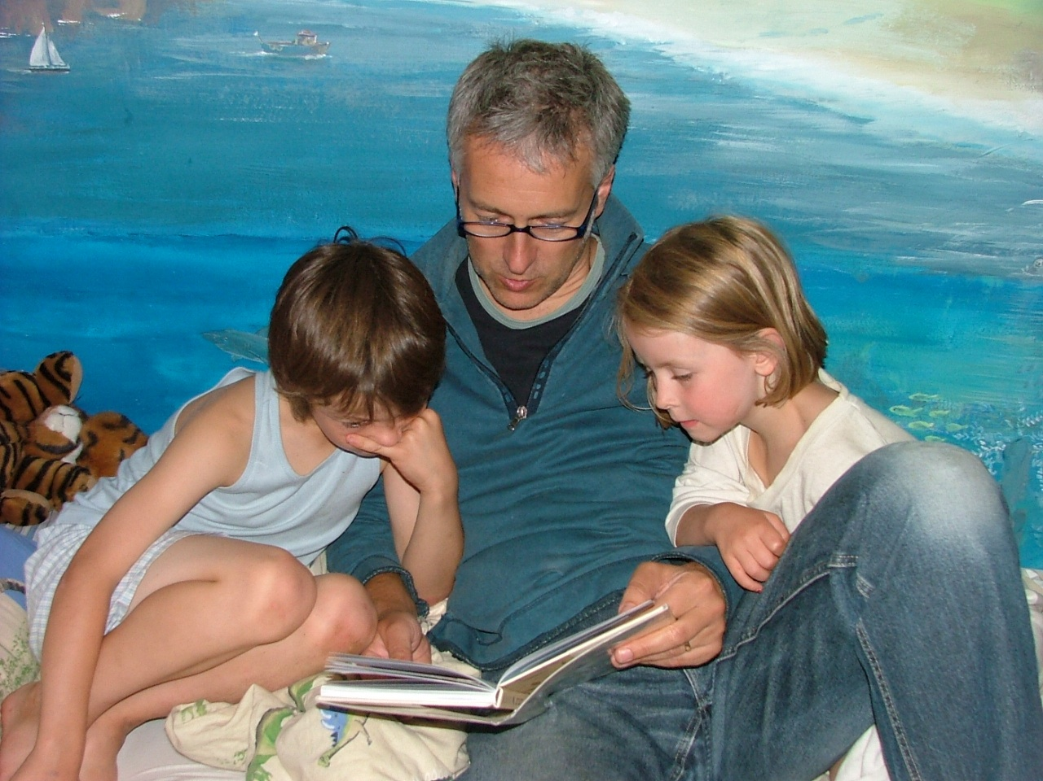
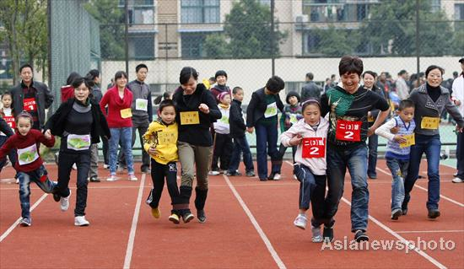
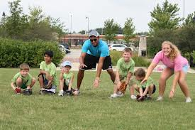
How do You Spell Love?
T
I
M
E
Spend time with your children
Do activities with them in order to stay connected to them
Get involved when they’re young so you can be welcome to stay involved when they’re older
Watch what they watch (sacrifice)
Notes:
Emad

Slide 21
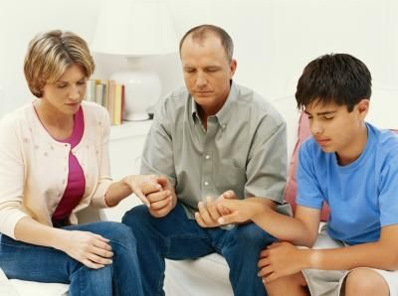
TIME
Family time is important
Plan activities to do together
Include spiritual activities
Monastery trips
Mission trips
Serve as Deacon together
Worship in Tasbeha together
Pick up other kids for spiritual activities
A family that prays together stays together
Notes:
Emad

Slide 22
Infants 0-1
”Train up a child in the way he should go, and when he is old he will not depart from it.” Proverbs 22:6
دَرِّبِ الْوَلَدَ بِمُقْتَضَى مَوَاهِبِهِ وَطَبِيعَتِهِ، فَمَتَى شَاخَ لاَ يَمِيلُ عَنْهَا.
Parents are more focused on physical well-being because infants are highly dependent on adults
But even infants take in information from surroundings
Listening to music in utero
Studies show that infants react to environment
Shouting causes stress, etc
Environment influences cognitive and emotional skills development
Notes:
Ann

Slide 23
Toddlers 1-2
Focus on motor skills and language
Understand much more than we imagine
Children are like sponges at this age
Story of “what does your mom work as?”
No TV prior to age 2
Not about content, but TV medium itself
More children diagnosed with ADHD
TV is not a good babysitter
Baby Einstein – no good
Notes:
Ann

Slide 24
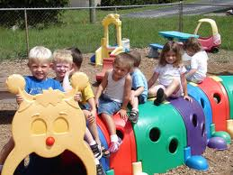
Preschoolers (3-5) and Children (6-8)
The focus is on socialization and learning to learn
They like to belong, do activities, learn by doing
They want to please you
ian behaviour
Welcome intense discussions
Train your kids to have a critical, discerning mind
Not to be naive and an empty plate for the devil to dump any disgusting garbage into it, and forcing your kids to swallow it
Birthday parties: if you don’t know the family, your child shouldn’t go alone
Use witnessed opportunities to communicate Christ (set the stage)
Notes:
Ann

Slide 25
Tweens (8-12)
Still primary school
Exposed to kids with older siblings
Start exhibiting characteristics of teens
Highly participative/social
Highly connected
Achievement oriented
Varying levels of maturity
Notes:
Emad

Slide 26
Teens (13 +)
13 and up
Teens want independence, seem rebellious
Think they know better than parents
This is normal
Critical to build trust by this point
Home needs to be a safe haven
Take your kid on a one-to-one trip (1 to 3 days) to bond
Good opportunity to talk about sexuality, after you have taken a book to prepare how to discuss it in a Christian manner
Notes:
Emad

Slide 27
Teens (13 +)
School dances, and school parties
”Thank God my kid has a girlfriend, and he is not gay" be-careful, that's the encouraged behavior that brought many to be bored and explore homosexuality
Charlemagne's questionnaire
St. George's school, Emmanuel School Christian School
CEGEP hall way, TV screens with programs about safe sex.
Notes:
Emad

Slide 28
Media
Control screen time (start when they are younger)
Allow electronic devices only on long car rides, play games instead, interact
Not on school days
No screens in bedrooms (start when they are younger)
Must keep computer in family room
An opinion: It’s better that they have exposure, not too much sheltering
الممنوع مرغوب
Facebook
has horrible pictures, some your kids put, some were put by others
Wastes tremendous amount of time
Even as innocent as searching the web: Virgin Mary on Google
Disallow pop-ups and ads
Watch movies first or search reviews on IMDB before showing to your children
When watching a movie as a family, pause the movie and explain questionable scenes
Investigate video games: Grand Theft Auto and others
Notes:
Ann
(so you save their eyes, keep them healthy, connect with them, not have to police them all day

Slide 29
My Marriage
Spend time on my relationship with my spouse
How we treat our spouses is how our children will treat theirs
Spend time alone, go on a date to bond, but also to communicate the path, and to strategize
Monthly family meeting
Plan for a cheerful family
You don't have to live miserably بكرة النكد
Don’t focus on winning the argument (pause & postpone)
Present a united front
Kids need to see stability, and witness a pure sense of affection at home so they don't replace that with impure affection
Notes:
Ann

Slide 30
Practical Parenting
GIGO
Garbage in = Garbage out
God in = God out
Immerse them in church
Some parents get angry if a servant disciplines his kid, happens at school also
Know their friends
If you can, control the sample
Celebrate baptism day
Divide and conquer: find your strength and divide the roles; bible, prayer, sport, errands
Notes:
Ann

Slide 31
Practical Parenting (cont’d)
Goodness and kindness points
Teach how to fish
You may have to make a decision: 2 luxury cars or 2 kids in heaven (do both need to work/ must work?)
Pick your battles
Use consequences, not punishments
Do I need to use physical discipline?
“Your punishment may hurt you, but it will hurt me more"
Talk to them as if they understand, don’t talk down to them
Notes:
Emad

Slide 32
Practical Parenting (cont’d)
Build their confidence, build their confidence, build their confidence
So they can handle their own challenges while you are not there to protect them
Different strengths - don't compare your kids to each other, to other kids or to your accomplishment - “each one is unique”
Running to serve the kids (middle of the night, kids have to witness self sacrificing attitude)
With older children, we have to strike balance between being their friend and their parent
Communication must be open, but authority needs to be clear
This doesn’t mean no tough love
Notes:
Emad
Build their confidence, build their confidence, build their confidence
Protect their confidence so they can handle everything that challenges them while you are not there to protect them against attacks on (faith, looks/beauty, smarts, them saying no, decisions, friendship choices, backgrounds and culture/heritage, ..)

Slide 33
We are at War
“For we do not wrestle against flesh and blood, but against principalities, against powers, against the rulers of the darkness of this age, against spiritual hosts of wickedness in the heavenly places.” Ephesians 6:12
فَإِنَّ حَرْبَنَا لَيْسَتْ ضِدَّ ذَوِي اللَّحْمِ وَالدَّمِ، بَلْ ضِدُّ الرِّئَاسَاتِ، ضِدُّ السُّلُطَاتِ، ضِدُّ أَسْيَادِ الْعَالَمِ حُكَّامِ هَذَا الظَّلاَمِ، ضِدُّ قِوَى الشَّرِّ الرُّوحِيَّةِ فِي الأَمَاكِنِ السَّمَاوِيَّةِ.
Notes:
Emad

Slide 34
Conclusion
Our children will go through difficult times – this is inevitable
The question is have we equipped them to deal with those difficult times
Do they have the tools to come out unscathed?
Responsibility of their upbringing rests with us
Notes:
Emad

Slide 35
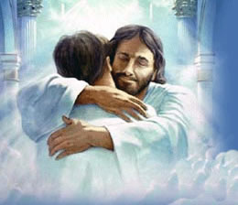
Conclusion Guide them to Heaven
Health
School (future)
Friends (social)
Marriage, or
Monastery, or
Living single
Love of God
Relationship with God
Notes:
Ann

Slide 36
Start with the End in Mind
Guide them to Heaven
Notes:
Ann

