Slide 1
Family In Christ Program
Session – The Role of Men and Women
Sunday, March 24th, 2013

Slide 2
Outline
A man and a woman in God’s eyes
Responsibility of a man to his wife
Responsibility of a woman to her husband
Men and their children
Women and their children
Why we have these roles

Slide 3
Genesis 2
“And the Lord God said, “It is not good for a man to be alone. I will also make him a helper comparable to him” v 18 وقال الرب الإله: ليس جيدا أن يكون آدم وحده، فأصنع له معينا نظيره

Slide 4
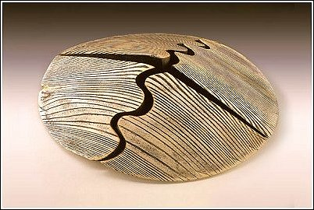
Genesis 2
Why did God wait to create woman?
What did Adam need to discover for himself? And what does what Adam said reveal?

Slide 5
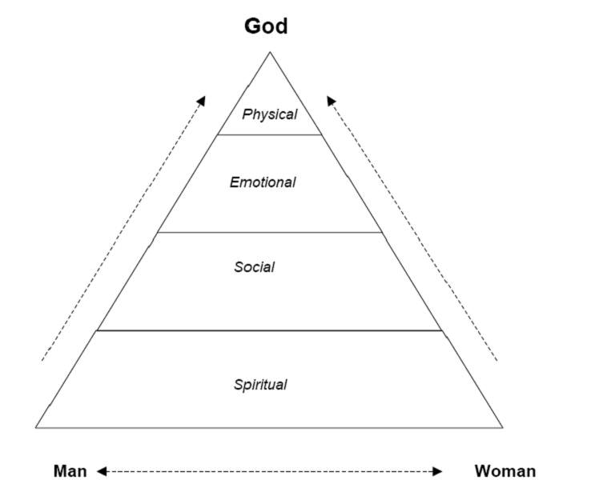
Marriage is a union of 3
God crowns the union – but is there a hierarchy of man and woman?
Distinguish roles from position
Learn from the Trinity
A good union must bear fruits
Not only children (some cannot)
What else?

Slide 6
In God’s eyes, marriage is founded on love
Love is a spiritual state which is proven by self sacrifice; in daily life this is also shown in submission
“Wives, submit to your own husbands, as to the Lord. For the husband is head of the wife, as also Christ is the head of the church” Eph 5:22
أيها النساء اخضعن لرجالكن كما للرب لأن الرجل هو رأس المرأة كما أن المسيح أيضا رأس الكنيسة، وهو مخلص الجسد
Is it possible for the man to fill the role of head and yet be equal to woman?
In taking our nature, Christ became the head of the Church

Slide 7
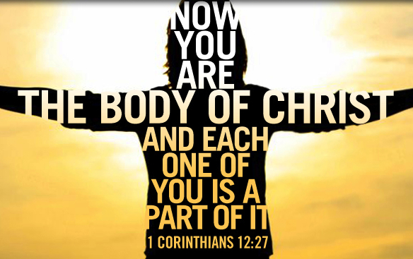
In God’s eyes, marriage is founded on love

Slide 8
In God’s eyes, marriage is founded on love
“Husbands, love your wives, just as Christ also loved the Church and gave Himself for her… he who loves his wife loves himself” Eph 5:22-28
أيها الرجال، أحبوا نساءكم كما أحب المسيح أيضا الكنيسة وأسلم نفسه لأجلها
من يحب امرأته يحب نفسه
St Paul devotes more verses to explaining to man how God wishes him to fulfill his role
If a man cannot serve his wife, the body is incomplete
The service required is daily self-sacrifice

Slide 9
The role of helper is: to help reach Eternal Life
In the ceremony of marriage, the priest prays:
O God, guard your servants…Protect their union in purity… grant us to be in the places of rest of Your saints in the Heavenly Kingdom
It is the role of each member to aid the salvation of the other, and of their children

Slide 10
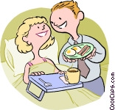
Responsibility of a man to his wife
The commandment to a man is:
My blessed son… Do all that is good for her. Have compassion on her and always hasten to do that which will gladden her heart.
The role of provider is not sufficient
Responsibility for her: do all that is good for her (spiritually)

Slide 11
Responsibility of a man to his wife
Understanding a woman
Good luck!
The instincts of a mother:
Tenderness
Protective instinct
Group support / sharing
Multi-tasking

Slide 12
Responsibility of a man to his wife
Understanding a woman
Is key to compassion
Importance in avoiding conflict
The role of leader in the family but not tyrant
For the husband is head of the wife as Christ is head of the church; and He is the Savior of the body Eph5:23
لأن الرجل هو رأس المرأة كما أن المسيح أيضا رأس الكنيسة، وهو مخلص الجسد
The husband needs to ask for wisdom

Slide 13
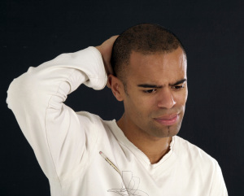
Responsibility of a man to his wife
Men are not good at showing affection
Let the husband render to his wife the affection due her – 1 Cor 7:3
ليوف الرجل المرأة حقها الواجب، وكذلك المرأة أيضا الرجل
Women need to feel loved
Why does a woman dress up and adorn herself?
Why does she get upset when he doesn’t notice?

Slide 14
Responsibility of a man to his wife
Hasten to do that which will gladden her heart
A woman does not reveal her wishes openly
It is for the man to discover
He must learn to listen to what she does not say

Slide 15
Responsibility of a man to his wife
Most importantly he must learn to put her ahead of himself
If Christ made Himself of no reputation, how much more the husband in his home (Philippians 2:7)
لكنه أخلى نفسه، آخذا صورة عبد، صائرا في شبه الناس

Slide 16
Responsibility of a woman to her husband
And you, blessed daughter, and happy bride…you must honour and respect him, do not disagree with him, but increase your obedience to him over what was commanded many times… receive him with joy and cheer. Do not frown in his face. Do not ignore any of his rights upon you, and fear God in all of your deeds with him

Slide 17
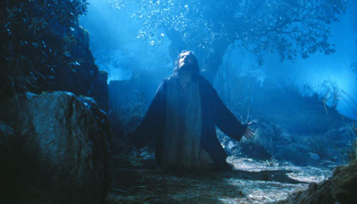
Responsibility of a woman to her husband
Most of the commandment emphasizes submission and obedience
Why?
Is it so difficult for women?

Slide 18
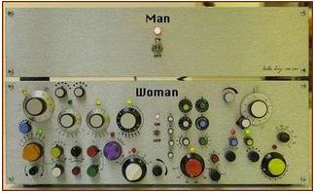
Responsibility of a woman to her husband
First understand a man:
His most difficult enemy is his pride!
It is the biggest risk to his eternal life
It is behind many of the traits you don’t like in him
(ex: it is why we never ask for directions)
It is why he defines his role as provider
It is why he may be a good leader
It is also why he may not find it as easy as you to submit to a Father in Confession

Slide 19
Responsibility of a woman to her husband
First understand a man:
He is made to handle pressure situations
But he is not made to understand subtlety!
His main complaint will be that women can’t be understood
He is less intelligent than you
(by about 3% on average)

Slide 20
Responsibility of a woman to her husband
Submission is a high level of spirituality
“Now when all things are made subject to Him, then the Son Himself will also be subject to Him who put all things under Him, that God may be all in all” 1Cor15:28
ومتى أخضع له الكل، فحينئذ الابن نفسه أيضا سيخضع للذي أخضع له الكل، كي يكون الله الكل في الكل
It is submission to the other when you are equal to the other that makes you as Christ Himself!
And the goal is the Salvation of the house – including the husband himself

Slide 21
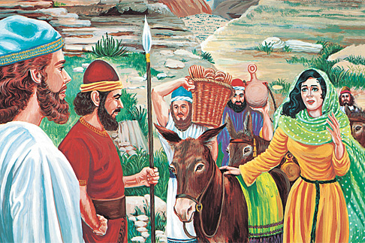
Responsibility of a woman to her husband
There is a wisdom in guiding a household
See Abigail and how she dealt with David in humility, saving her household (1 Sam 25)
There is a difference between humiliating him in public (in his own mind) and correcting his foolishness with wisdom
Subtlety is in the nature of a woman

Slide 22
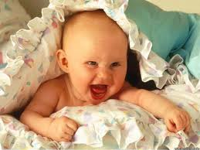
Responsibility of a woman to her husband
A woman is the joy of the household
How can a man be upset when she greets him with a smile and bears with his complaints?

Slide 23
Responsibility of a woman to her husband
The bottom line is: fear God in all of your acts with him
It is most important that a woman also empty herself of pride and place the LORD foremost in the family structure
It is how she can serve her children and truly build a church in her home

Slide 24
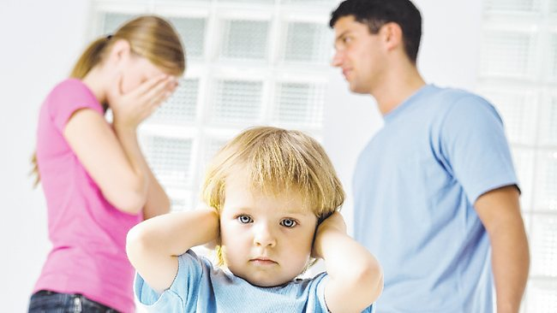
A message to parents
Never fight in front of your children – they deserve a peaceful home

Slide 25
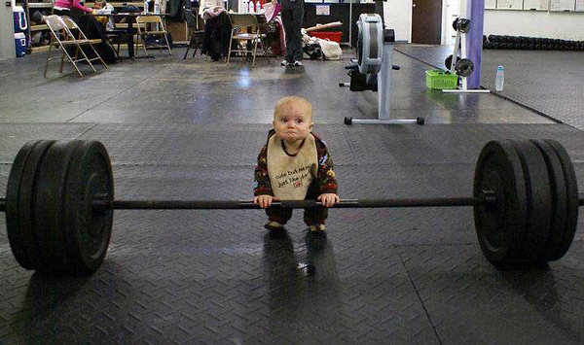
Men and their children
A man is by nature proud of his children
This pride may manifest in unrealistic expectations of the children
Because of this he may be too harsh and demanding
Nevertheless, he also has the duty to be strict when appropriate

Slide 26
Men and their children
“And you, fathers, do not provoke your children to wrath, but bring them up in the training and admonition of the LORD” Eph 6:4
وأنتم أيها الآباء، لا تغيظوا أولادكم، بل ربوهم بتأديب الرب وإنذاره
“Fathers, do not provoke your children, lest they become discouraged” Col 3:21
أيها الآباء، لا تغيظوا أولادكم لئلا يفشلوا

Slide 27
Men and their children
It is also expected that a Father be spiritually mature enough to teach his children:
“I have written to you fathers, because you have known Him Who was from the beginning” 1Jn.2:13
أكتب إليكم أيها الآباء، لأنكم قد عرفتم الذي من البدء.
This is meant in the spiritual sense, and applies to what each father should be

Slide 28
Men and their children
In turn children ought to show the appropriate respect for their parents (or any adult)

Slide 29
Women and their children
“Behold, children are a heritage from the LORD, the fruit of the womb is a reward” Ps 127:3
هوذا البنون ميراث من عند الرب، ثمرة البطن أجرة

Slide 30
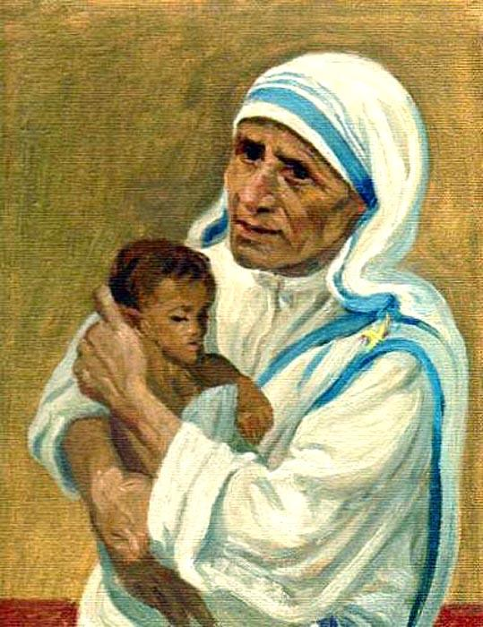
Women and their children
A mother is the cornerstone of the raising of a child
She provides the child with love
She provides the child with knowledge
She teaches the child prayer, the Word of God, the traditions, and rites, and hymns of the Church (along with the father of course)
She protects her child without spoiling

Slide 31
Women and their children
“Behold, children are a heritage from the LORD, the fruit of the womb is a reward” Ps 127:3
هوذا البنون ميراث من عند الرب، ثمرة البطن أجرة
Her success is measured in how the child turns out:
Therefore the fruit of the womb is a reward
This specific description was also applied to the Christ Himself and was a promise from the Old Testament (Deuteronomy 7) to those who were obedient to God
We take as a lesson St Mary’s motherhood
How wonderful it would be if people said about a child “Blessed is the womb that bore you” Luke 11:27
طوبى للبطن الذي حملك

Slide 32
Why do we have these roles?
We know that God’s design for the Church as a whole has been to give each member a role and a function “for the edifying of the body of Christ… every part does its share, causes growth of the body for the edifying of itself in love”
Ephesians 4:12 – 16
لبنيان جسد المسيح…الذي منه كل الجسد مركبا معا، ومقترنا بمؤازرة كل مفصل، حسب عمل، على قياس كل جزء ، يحصل نمو الجسد لبنيانه في المحبة

Slide 33
Indeed, these things are not ordained by chance
For God is not the author of confusion
1 Cor 14:32-34
لأن الله ليس إله تشويش بل إله سلام
This was said about the Churches, but applies also to the churches in our homes

Slide 34
From the start God left each member in need
In the same way God left Adam to feel his need for one to help him and complete his deficiencies (to help him spiritually), God left Eve with deficiencies, and also where there are children, they also help to edify the church in the home

Slide 35
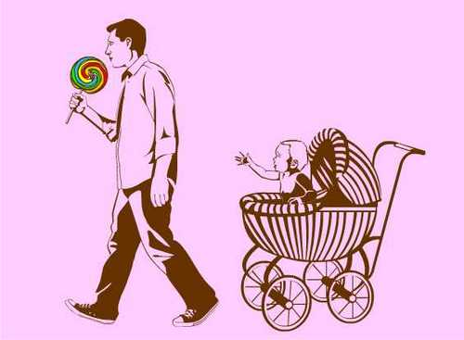
Where there are children….
The raising of the children themselves helps the parents to grow
This also, as with each parent involves bringing them out of their selfishness

Slide 36
Where there are no children….
While this is a hard cross to bear, we know that God does all things for the good

Slide 37
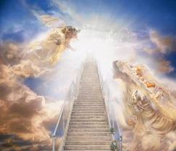
The end goal, is the end result, is only One

