Slide 1
Family In Christ Program
Session 5 – Pornography & School - Related Issues
Sunday March 31th, 2013

Slide 2
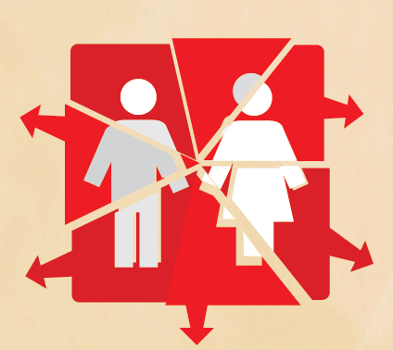
1. Pornography
Problem # 1: Teenagers believe that pornography is a harmless pastime.
Pornography is not perceived as a sin of impurity.
It is like a cancer that is effectively destroying the family unit.

Slide 3
1. Pornography
Problem # 2: Teenagers think that as long as they are not physically doing the act there is nothing wrong.
"But I say to you that whoever looks at a woman to lust for her has already committed adultery with her in his heart. If your right eye causes you to sin, pluck it out and cast it from you; for it is more profitable for you that one of your members perish, than for your whole body to be cast into hell" (Mt 5:28-29).
28 وأما أنا فأقول لكم : إن كل من ينظر إلى امرأة ليشتهيها، فقد زنى بها في قلب
29 فإن كانت عينك اليمنى تعثرك فاقلعها وألقها عنك، لأنه خير لك أن يهلك أحد أعضائك ولا يلقى جسدك كله في جهنم

Slide 4
1. Pornography
It can lead to lifelong problems.
Sex is no longer perceived as a gift that God bestowed on married couples.
It is no longer a pure and private expression between married loved ones.
"Do you not know that you are the temple of God and that the Spirit of God dwells in you? If anyone defiles the temple of God, God will destroy him. For the temple of God is holy, which temple you are" (1 Cor 3:16-17).
16 أما تعلمون أنكم هيكل الله، وروح الله يسكن فيكم
17 إن كان أحد يفسد هيكل الله فسيفسده الله، لأن هيكل الله مقدس الذي أنتم هو

Slide 5
1.1 Accessibility
Pornography was difficult to access.
Difference between Internet pornography and “traditional” pornography, for the addict, is that there is constant temptation wherever you are: at work or at home, at any point on any computer or mobile device.

Slide 6
1.1 Accessibility
First glimpses of pornography :
online pop-ups and ads
Also with partial nudity and virtual sex scenes on TV programs that can trigger enough curiosity that will lead to the sin.

Slide 7
1.1 Accessibility
Once tempted: there is little-to-no age verification to prevent a curious child from entering a porn site.
- associated with popular cartoon characters and teen icons
- cross-marketing between online gaming and the pornography industry
check the game ratings before allowing your kids to play.

Slide 8
1.1 Accessibility
Kids can also encounter pornography on social networking sites like Twitter and Facebook.

Slide 9
1.2 Statistics
372 million pornographic Web pages; 72 million people visit porn sites each year.
35% of all internet downloads are pornographic
In the US, a new porn video is completed every 39 minutes
2.5 billion emails per day are pornographic
Every second, over $ 3000 is spent on pornography and over 30 000 users are viewing porn sites.
The average child sees their first porn by the age of just 11. Between 60 and 90 per cent of under-16s have viewed online pornography.

Slide 10
1.2 Statistics
2/3 viewers are male, 1/3 female (it used to be ¾ and ¼)
The largest group of viewers of internet porn is children 12-17 years old.
The most common ways people have accidentally reached pornographic content on the Web are pop-up windows (55%), misrepresented links, misspelled URLs and auto links within emails.

Slide 11
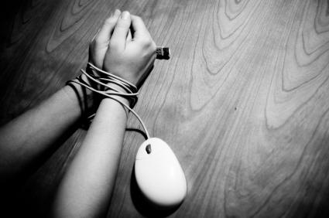
1.3 Consequences
Can develop into an addiction
Mental images can never be erased.

Slide 12
1.3 Consequences
Sexual addiction can be harder to treat:
addictive substance cannot be physically removed from the addict's body.
This is the first addictive substance for which there is no hope for detoxification.

Slide 13
1.3 Consequences For the Youth
Prolonged exposure to pornography leads to:
An exaggerated perception of sexual activity in society
“Only” 40% have reported to have had sex (grade 9 and up)
Pornography negatively impacts the emotional and mental health of a child.
Teenagers who view pornography will often act out the behaviors they have seen.

Slide 14
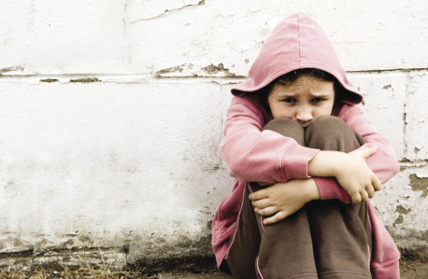
1.31 Consequences for the Youth
Incur persistent emotional problems such as depression, shame and remorse.
“Through the Lord’s mercies we are not consumed, Because His compassions fail not. They are new every morning; Great is Your faithfulness.” Lamentations 3:22-23
22 إنه من إحسانات الرب أننا لم نفن، لأن مراحمه لا تزول
23 هي جديدة في كل صباح . كثيرة أمانتك
Believe that the most gratifying sexual satisfaction is attainable without love or true affection.

Slide 15
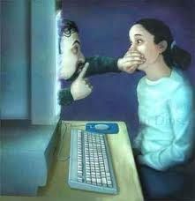
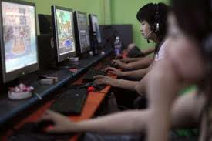
1.31 Consequences for the Youth
Through multiplayer online games, kids can interact with strangers from around the world. Predators are using online gaming platforms to connect with children and to groom children into having an offline sexual relationship.
At least 20% of children have admitted to receiving sexual solicitations from adults online.

Slide 16
Predator becomes the kid’s best friend
Promise of lasting romance
Crime against youth
Kid relies on predator emotionally
Online predators drive a wedge btw kid and parents or friends
Kids seek attention
Parents must provide the attention that kids need.

Slide 17
1.32 For the adult
51% adults believe that pornography raises men’s expectation of how women should look and changes men’s expectations of how women should behave.

Slide 18
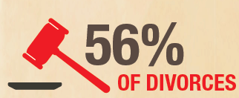
Believe that being married or having a family are undesirable
More than half of those engaged in cybersex lost interest in sex with a loved one.
Therapist are treating more and more couples for a spouse’s porn addiction. Couples are coming forward with this all the time.
56% of divorces involved one person having an obsessive interest in pornography.

Slide 19
1.33 The Family Unit
Spouses of sex addicts often experience:
emotional problems
social embarrassment
physical abuse or unwanted touching in public and private
sexual pressure to engage in degrading and unsafe sexual behaviors.
The adverse effects experienced by children of cybersex addicts include:
exposure to Internet porn
involvement in parental conflicts
parental neglect
the breakup of their parentsʼ marriage.

Slide 20
Family Unit - Salvation
“Believe on the Lord Jesus Christ, and you will be saved, you and your household.” Acts 16:31
فقالا: آمن بالرب يسوع المسيح فتخلص أنت وأهل بيتك
Holy Matrimony is the Mystery depicting the union of our Lord Jesus Christ with His. The Church is made up of men and women; their marriage union is immensely important for their own salvation. (His Grace Bishop Youssef)
"Unless the Lord builds the house, they labor in vain who build it" (Psalm 127:1).
إن لم يبن الرب البيت، فباطلا يتعب البناؤون. إن لم يحفظ الرب المدينة، فباطلا يسهر الحارس

Slide 21
1.4 Fighting the Addiction

Slide 22
Basics for Every Age
Keep the conversation going and the lines of communication open.
Don’t wait until they come to you.
Create a list of internet rules and computer rules.
If they are young: put the computer(s) in a common “public” room.
If they are teenagers: place the computer in their room in a way that you can see it when you enter the room and pop in on them from time to time.
No closed door policy.
Use parental controls to filter, to monitor, to set time limits and to tailor your child’s online access.
Remind your kids to come to you if they every feel scared, threatened or uncomfortable by something or someone they encounter online.
Supervise and monitor use of all internet-enabled technologies.

Slide 23
More Tips for Parents
Familiarize yourself with social networking sites.
Talk with your kids about what appropriate behavior looks like online, and help them to think before they post.
Remind your kids that there are no take-backs online.
Know what your kids are doing and with whom they are communicating.
Don’t overreact.
Talk to them about the dangers and sinful nature of pornography.

Slide 24
2. School-Related Issues
Religion
Discipline at home
Sex

Slide 25
2.1 Sex
A) Elementary objectives
Describes the anatomy and the function of the main organs of the female and male reproductive systems.
Explains the stages of growth and development in humans.
Describes the physical changes that take place during puberty.
These topics are to be introduced in grade 5 (10-11 year olds) and tested in grade 6 (11-12 year olds).

Slide 26
High school objectives
B) Topics introduced in grade 8
male and female reproductive organs.
stages of human development during pregnancy.
contraceptive methods (e.g. condom, ovulation suppression agents)
advantages and disadvantages of different contraceptive methods
sexually transmitted and blood-borne diseases
physical and psychological changes that occur at puberty

Slide 27
What Teachers Assume
Assumption: teenagers can/will have sexual relations.
Therefore we should teach students how to protect themselves
Some will teach about abstinence (subject to teacher’s judgment)
School nurse – condoms
How to put on condoms (science or ERC → no sex education as of 2003 in Quebec)
Homosexuality
Subject to teacher’s judgment – tolerance versus (choice or nature)
Quebec – commercials against homophobia

Slide 28
Quebec civil law & Youth Clinics
The Québec Civil Code recognizes the right of young people 14 years of age and older to seek and receive healthcare services in complete confidentiality.
Children under the age of 14 need the authorization of their parents or guardian (tutor) to have plastic surgery or a routine operation, to be given a prescription, or to receive rehabilitation care or a transplant.
However, they may make their own health-related decisions when the care is necessary to ensure their physical and psychological health.
Sex, drugs, addictions etc..

Slide 31
2.2 Religion
All religions are discussed (elementary and high school).
Traditions, main “characters”, story, rules, obligations, rites.
Tolerance
All perspectives are taught
Debate controversial issues
Atheism and relativism
New age religions
Teacher’s input
Hold on to Church teachings!

Slide 32
2.3 Child welfare
“Child welfare”: government and private services designed to protect children and encourage family stability.
safeguard children from abuse and neglect.
investigate allegations of abuse and neglect
supervise foster care and arrange adoptions.

Slide 33
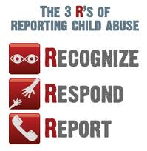
Reporting Child Abuse or Neglect
Everyone has a duty to report child abuse and neglect under Canadian child welfare laws.
This is called the 'duty to report'. Every person in Canada has the duty to report known or suspected child maltreatment by law.
You are obliged to report child maltreatment if you know or suspect it is occurring.

Slide 34
Discipline @ Home
Shake, push, grab, or throw: includes pulling or dragging a child as well as shaking an infant
Hit with hand: includes slapping and spanking but not punching
Punch, kick, or bite: includes any hitting with other parts of the body (e.g., elbow or head)
Hit with object: includes hitting with a stick, a belt, or other object, throwing an object at a child, but not stabbing with a knife

