Slide 1
Family In Christ Program
Session 6 – Integrating God in our Homes
Our Home a Church
Sunday, April 14th, 2013

Slide 2
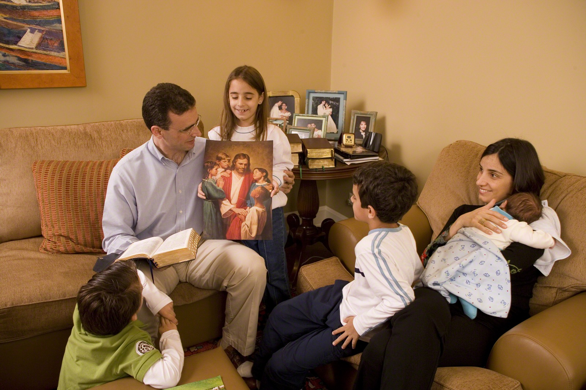
Moses tells God’s people:
⁶ “And these words which I command you today shall be in your heart. ⁷ You shall teach them diligently to your children, and shall talk of them when you sit in your house, when you walk by the way, when you lie down, and when you rise up. (Deut 6:6-7)
⁶ وَضَعُوا هَذِهِ الْكَلِمَاتِ الَّتِي أُوصِيكُمْ بِهَا عَلَى قُلُوبِكُمْ،
⁷ وَقُصُّوهَا عَلَى أَوْلاَدِكُمْ، وَتَحَدَّثُوا بِهَا حِينَ تَجْلِسُونَ فِي بُيُوتِكُمْ، وَحِينَ تَسِيرُونَ فِي الطَّرِيقِ، وَحِينَ تَنَامُونَ، وَحِينَ تَنْهَضُونَ.
ﺍﻟﺘﺜﻨﻴﺔ 6:6

Slide 3
Let’s agree on the basics
The home has the primary role in the spiritual life of their kids
Kids learn much more from what we do than what we say
We cannot fake it
My relationship with God is very important (can’t give what I don’t have)
Raising Godly kids can affect the lives of many generations to come

Slide 4
My Interviews
I interviewed many of my role models:
Some select Mothers (both young & “less young”)
Some select Fathers (both young & old)
Young Adults speaking about their parents
This session is based on
real-life experiences & advice
& ideas from real parents.
Notes:
Badam ana soghayar, we awladi lessa soghayareen, makontesh 3ayez en el session da yekoun nazari bass – atmanna eno yekoun 3amali.
3ashan keda fakkart enni a7san 7aga a3melha enni akkallem ma3 el ahali el beyhebbo Rabbeno awi, wakhod men khebrethom, we nassaye77om, we afkarhom el gamila.
Ekkalemt ma3 Ommahat we Abbahat, kobar we soghayareen, we ma3 Shabab we Shabb’at bey7ebbo Rabbena bardo awi bardo, ennohom ye’oulili ahlohom kana beyet3amlo ma3ehom ezzay.
Mo3zab el hatessma3ou men khebrathom we nassayehhom we afkarhom.

Slide 5
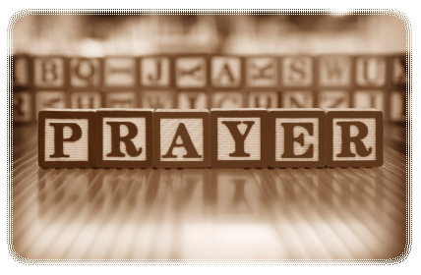
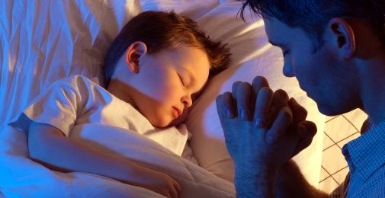
The Main Ingredient
Central point for all
We will give you a tool: The Parent’s Prayer
Be anxious for nothing, but in everything by prayer and supplication, with thanksgiving, let your requests be made known to God. (Phil 4:8)

Slide 8
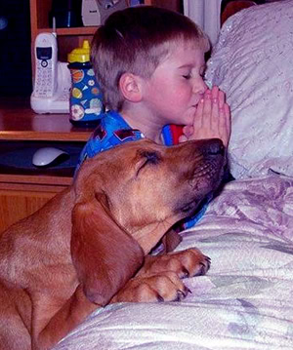
A Simple Transfer
They say: If parents love God and live for God, this lifestyle will be transferred to the Children naturally, without too much pushing, nagging, or pressuring them
If couple has strong relationship with God, good foundation!

Slide 9
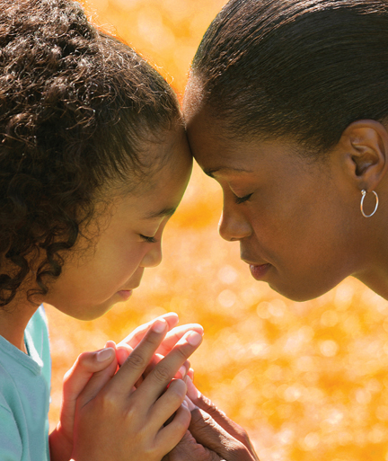
First Icons: St. Mommy & Daddy
The first icon of God that the child sees is the face of mother & father
What lady said about her Dad:
I know God’s love because I tasted my Father’s infinite love.
How much more could God the Father love me?!

Slide 10
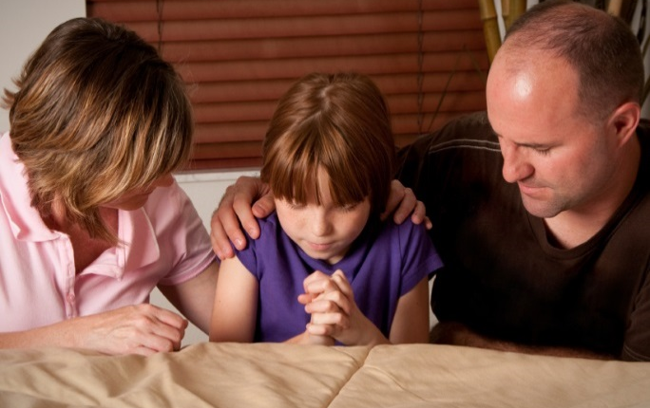
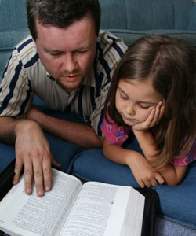
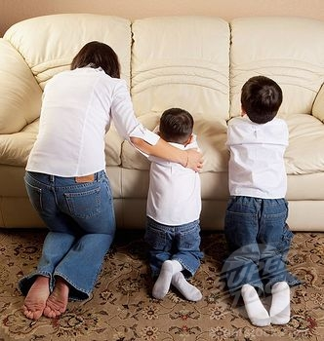
Your Home: A Church
St. Paul calls the home: “the church which is in your house”
St. Clement: the 2 or 3 gathered in Christ’s name represent husband, wife and child”

Slide 11
MAKE time to get filled
Wake up a little bit before the kids and spend some time with God in prayer
Talk to God in the car
Lunch break with God
For those who don’t work, or part time, or grown kids...library
Before bed

Slide 12
Home Environment & Family Lifestyle

Slide 13
The 5 Senses at Home
Touch: Signing the cross, kissing icons, …
Mouth: Praising God & Fasting
Sight: Hang icons, saint movies
Smell: Candles and Incense
Hear: Hymns, Bible, hearing stories, sermons

Slide 14
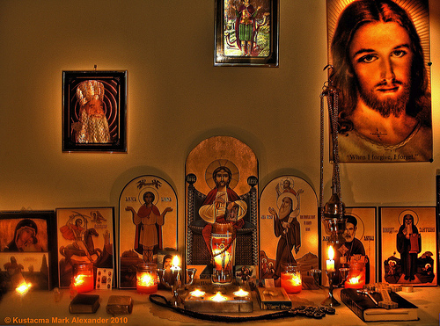
Home Prayer Corner
A place to pray as a family
Let each choose icon to add to Prayer corner
A Time to meet (after Dinner or before the first child goes to bed)
Copies of Agpeya’s and some Hymns maybe
Small whiteboard … sick kids at school, etc

Slide 15
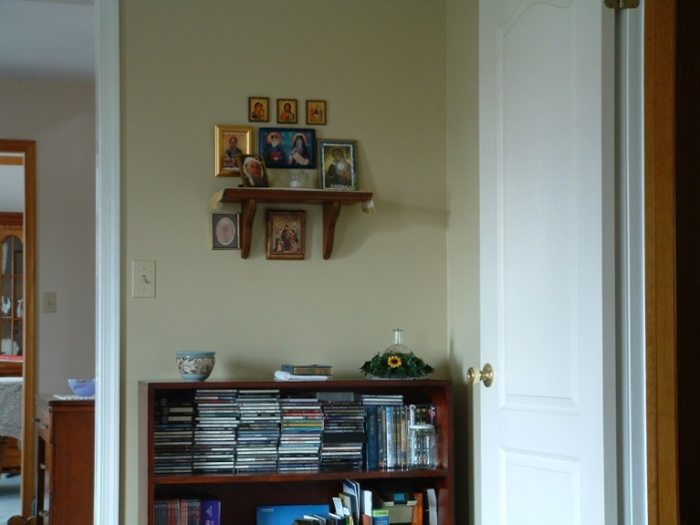
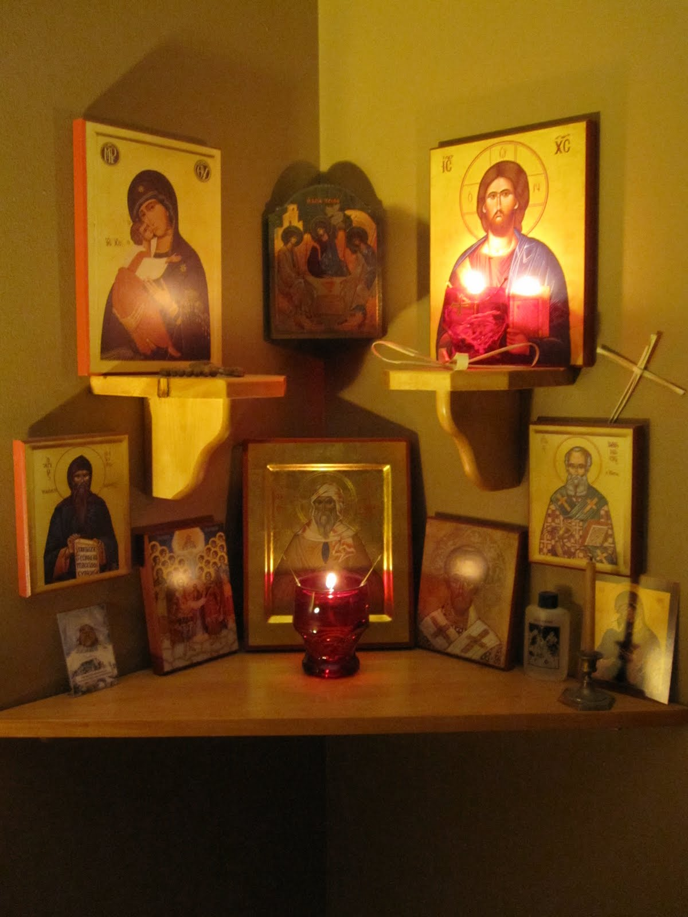
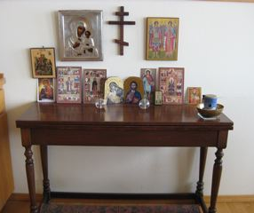
Home Prayer Corner

Slide 16
Bible
Read the Bible daily!
Until Prim. 2: parent reads picture Bible to child
3rd: parent reads regular Bible with child
4^{th:} they read regular Bible as you sit with them
5th: they read Bible on their own; possible parent discussion afterward.
Idea: A verse to memorize during dinner
Next day, the person that can recite the verse gets a reward!

Slide 17
Bible (cont’d)
Use questions to encourage them to read: http://www.suscopts.org/resources/bible-study/
Visual Aids
Bible games (trivia, puzzles, board)
Flash-A-Cards
Nest Entertainment DVD’s (www.nestlearning.com)

Slide 18
Our Identity?
Some parents feel “Now we’re in Canada” …
Yes, Canadian, Egyptian but mostly CHRISTIAN (flag height)
Sign of the cross always, even on exam papers
Good Friday, Jan 7th off & Fasting
If they say “Don’t wanna be different” >
Noah & Fam
St Athanasios
Daniel & Friends

Slide 19
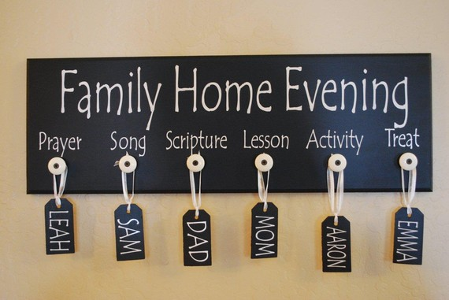
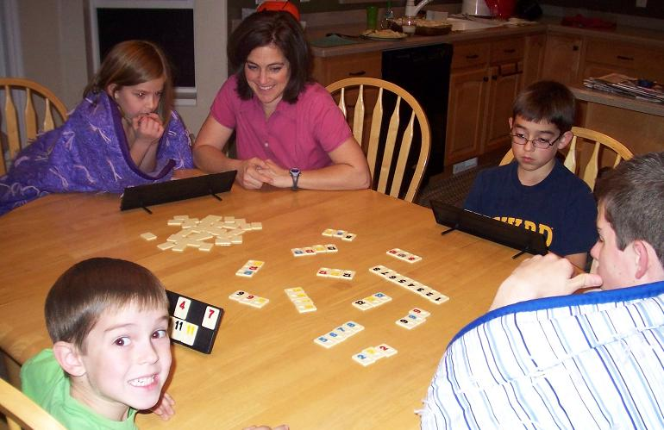
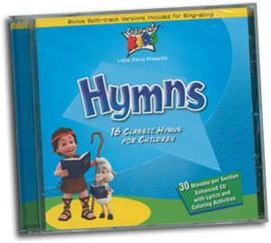
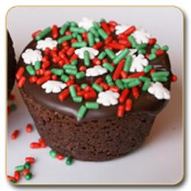
Family Home Evening

Slide 20
Computer Usage
Computer is door to the outside world
Where they are going?
Who they are with?
For how long?
Speak to them about it
Put it in a shared space like living room
Install parental control software

Slide 21
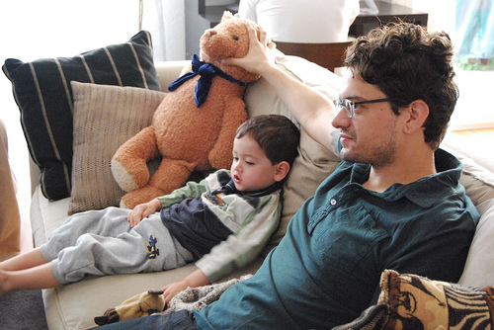
Television
Set time-limit
Content (choosing the baby sitter)
My school friend
Robs precious time
Very powerful at influencing the mind
Use it to watch saint movies, or well-chosen films, good cartoons

Slide 22
Keep them busy
One mom: as much as their schedule allows
In school, city, Church
Sports, music, etc.
Reduces idle time, drama, computer, good release of energy)
Be involved with them
Retreats, Church trips

Slide 23
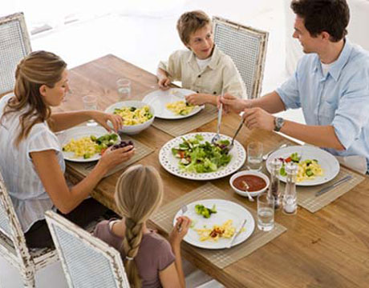
At the Dinner Table
Family Sacrament
No TV (even CTV)
Take turns praying
Ask about their day
1 fam: circle of thanks
Read today’s saint story
Read a Bible passage for sp. event of the day
Don’t remove dishes

Slide 24
One Mom’s Fridge lessons
Fridge is high-traffic spot
Each week after Church, summarizes Gospel message into one sentence or verse
Puts in on the Fridge
Sometimes asks kids to help decorate it

Slide 25
Friendships with Saints
When sick, tell kids to ask a saint for prayers … their faith is strong (my son’s crying story)
Hockey & Archangel
Getting icon of a saint, we told our kids “that means this saint wants to be friends with you”

Slide 26
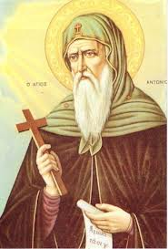
Friendship with Saints
Idea of Saint’s Day
One mom says her son loves to hear the story of St Anthony because his name is Anthony
Another family suggests, if your child is named after a saint, to celebrate your child on that saint’s day, and read his story, tamgeed, cake

Slide 27
Home Environment
Always calm
Always respectful
Always something nice playing (like hymns or Tasbeha or liturgy) … get a little CD player!
Young adult tells me house was always calm … allowed us to read, to study … it was peaceful
Safe space to speak about anything, including sex (no overreacting)

Slide 28
Ideas for Teaching kids Service

Slide 29
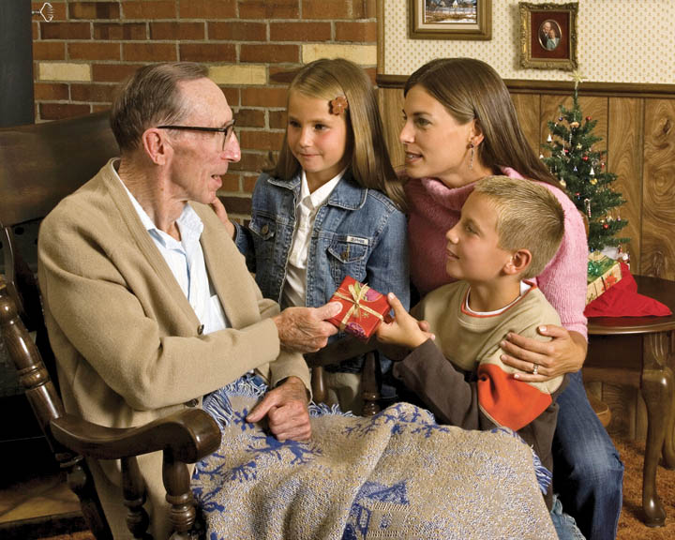
Adopt an Elder
Other than Geddo
At least 1 visit/month
Encourage them to use their talents to make little gifts each time (art, writing, baking, sewing, music…)

Slide 30
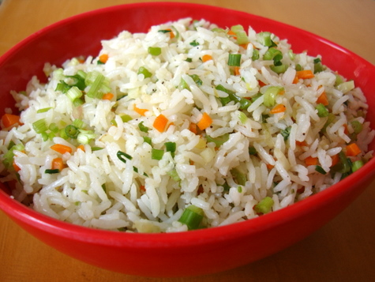
Monthly Rice Meal
To feel with the poor
They put money saved in envelope and send it to poor country
Their prayer is focused on the poor, that God meets their need
(just a creative idea to teach kids to care for others)

Slide 31
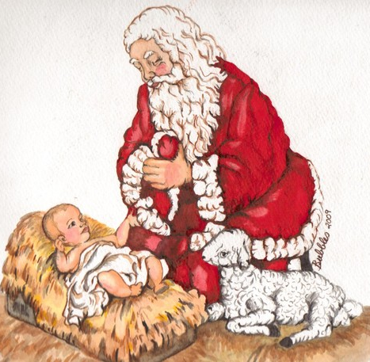
Christmas
Jesus is Reason for the Season
Sing “Happy Birthday Jesus”
List of what would make J. ☺
Preparing gift for poor kids (shoebox)
Donating toys (story of mom with 3 teenage boys)
Singing Christmas songs at Hospitals
Baking cookies for neighbors

Slide 32
Simple Services
Clean the Church with your kids
Ask about a friend who is sick
Calling a lonely Elder
Throw out the trash at Church
>Open their eyes to the everyday things

Slide 33
Ideas for Feasts & Events

Slide 34
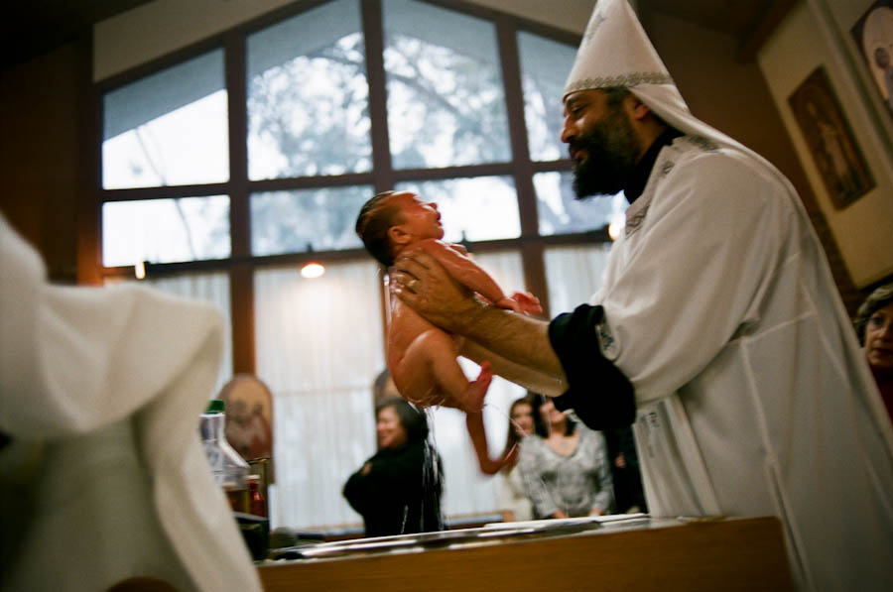
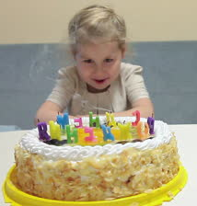
Celebrate Baptism

Slide 35
Thanksgiving
Each child write a Thank You card to God, and a card to thank someone who helped them or did something for them
Explain why Church starts every prayer with Thanksgiving Prayer
Have a little prayer meeting and thank God for everything you can think of

Slide 36
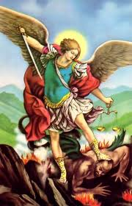
Icon, Tamgeed & Feteer
Any saint that you have a picture or icon for, place it with a candle on their feast day
Tamgeed for St. Mary on her feast days (and other saints)
Feteer Malak on Archangel Michael’s feast days (pray for ppl)

Slide 37
Being a good Example (At Home & in Church)

Slide 38
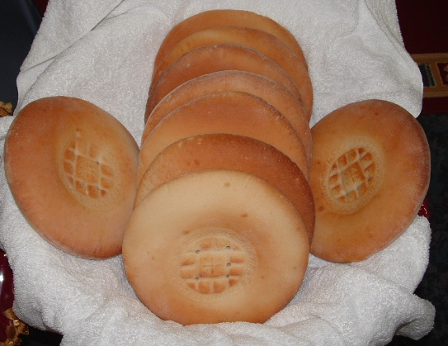
Late for Church?
Coming late: Kids know that for important things, we have to be on time (school, music lesson, etc.)
Being late tells your kids that … the place we are now going is not important.
The Person we are now meeting is not important.
Taking communion when we came late gives the same impression about the body of Christ

Slide 39
Forgiveness
Ensure that everyone forgave everyone before communion (Matt 5:23)
If you make a mistake, say sorry and ask for forgiveness
If they don’t forgive, don’t take communion

Slide 40
Confession
Explain it simply
Go together as a family
Kids could start from Primary Grade 1
Normally if parents don’t, kids won’t

Slide 41
The Church in their blood
Always at Masses, Asheyas, Tasbeha from young age
One mom tells me … It becomes their lifestyle (even fasting, dressing, hymns…)
Another mom’s funny Friday story
Stand/sit next to mom or dad at Church
Some parents “in heaven” at church alone

Slide 42
Be an example
Prayer, Bible open
Confession
Punctuality
Tithing
Serving
Virtues (ex: Honesty)
Chocolate/Hilton towel
Honest mom shopper
Kindness (to spouse)

Slide 43
An Interview with a Young Adult about her Parents
Notes:
Gau el Bet we selouk el Osra

Slide 44
Interview with Daughter
What role did your parents play in raising you to love God and the Church?
1. They lived in Jesus and prayed a lot for us! I think that's what mattered most - they practiced what they preached - and God blesses.
2.They didn't force or nag - somehow going to Church, reading the Bible, etc. was not a chore
3. Dad always taught us hymns during car rides - he made it a fun thing - we loved it. They used to read us saints stories when we were young kids - that was also very fun.

Slide 45
Interview (cont’d)
4. They also focused on creating a balance of religious-related activities and secular activities (sports teams, travel, etc.) So not all friends were from church or everything at church - church was always a pleasure and never too much. 5. They are excellent listeners ... so we grew up enjoying to talk with them, unload to them + get advice from them. They didn't create too much drama ... which made speaking with them easier. 6. Liturgy was considered very sacred - dad wears a suit, we are not allowed to wear jeans... We could not wander or sit with friends - mom was pretty strict about that.

Slide 46
Interview (cont’d)
7. Home was usually quiet and peaceful - made it easy to read, study, chat as a family. 8. TV, Nintendo was limited to 2 hrs per day when we were growing up. We were encouraged to read -we often read comic book bible in our free time. 9. They were not afraid to discipline us. They weren't lenient. They clearly stated what they thought was right and wrong, and they were usually not negotiable. Yet, they were super loving. They did everything possible to make us happy (as long as it was good for us).

Slide 47
Time Time Time!
Love = spend time with kids
Be a good listener
Undivided attention
One father tells me “Kids don’t grow on trees. You need to invest time and effort. Sometimes you sacrifice your time, comfort, even your career.” sow/reap
One mom tries to work less in summer to see kids more
One mom at bedtime

Slide 48
Words of Wisdom
The words of a very wise man (in his 80s): “The best investment a person can make in life is investing in the raising of his children.”

Slide 49
Enjoy Your family in Christ

