Slide 1
DRUG USE AND ABUSE

Slide 2
CANNABIS

Slide 3
CANNABIS: 3 TYPES
1. Cannabis/hashish oil
2. Hashish (or resin)
3. Herbal cannabis or Marijuana
**According to the United Nations, cannabis is the most widely used illicit substance in the world.

Slide 4
Good to know...
All 3 types of cannabis (hash oil, hash, and marijuana) all come from the same plant:
CANNABIS SATIVA PLANT

Slide 6
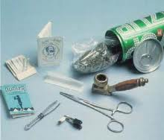

Slide 7
STATISTICS FOR CANADA (2004)
44.5% of Canadians aged 15 and older have used cannabis at least once in their lifetime. That represents nearly 11 million people.
50% of boys and 40% of girls among Grade 10 students had used cannabis during the last 12 months

Slide 8
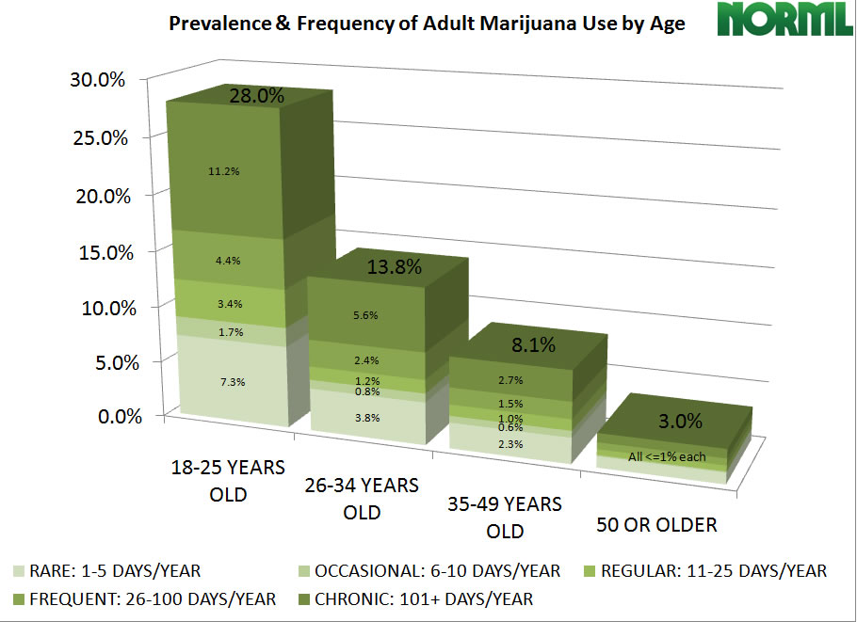

Slide 9
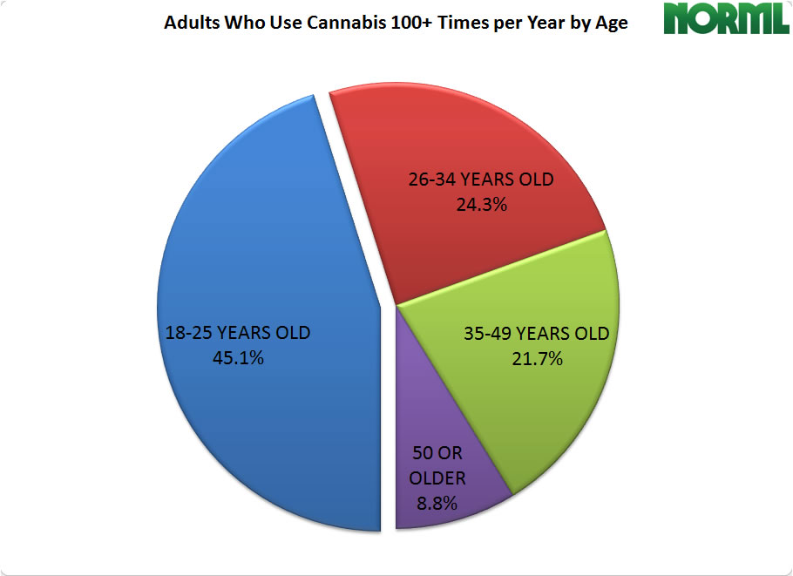

Slide 10
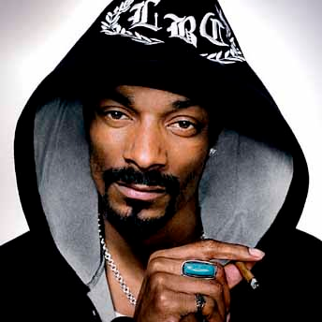

Slide 11
BUST: 105 tonnes, $340 million

Slide 12
Street names for Marijuana
Aka:
Pot, Mary jane, weed, ganja, grass, happy dope, peace tobacco, dreamy smoke, wacky weed, reefer, mota, tree, dank, ace, funk, funny stuff, Marley, Texas tea, boo, jolly green, happy tobaccy, kronic, herb, green, dope, loco weed, sativa, skunk, smoke, sticky icky, magic smoke, giggle smoke, I miss my mommy, etc.
over 200 names to describe Marijuana

Slide 13
PHYSICAL EFFECTS
red eyes
spontaneous laughter
increased hunger (often called "munchies")
mild paranoia, anxiety or panic
impaired reaction time, coordination and motor skills
increased heart rate and decrease in blood pressure (may lead to fainting)
dry mouth and throat

Slide 14
The gateway drug theory is the theory that the use of less deleterious drugs may lead to a future risk of using more dangerous hard drugs and/or crime. It is often attributed to the use of several drugs, including tobacco, alcohol, and cannabis.

Slide 15
COCAINE

Slide 18
CRACK

Slide 21
ECSTACY

Slide 22
DEFINITION
Ecstasy, comes from the Ancient Greek word, έκ-στασις (ex-stasis), "to be or stand outside oneself”, a removal to elsewhere...
A state of being carried away by overwhelming emotion...

Slide 23
DANGERS OF MDMA
Alters the activity of chemical messengers, which enable nerve cells in the brain to communicate with one another.
It interferes with the body’s ability to control its temperature (severe medical consequences, death).
Contains a number of other harmful drugs in it (caffeine, cough suppressants, cocaine).

Slide 26
GHB (gamma-hydroxybutyrate) i.e: liquid ecstacy, liquid x, soap, fantasy, grievous bodily harm, etc.

Slide 27
What is GHB?

Slide 28
Date Rape Drug
As a street drug, GHB is a man-made chemical that comes from illegal labs. Odourless and tasteless, dissolves easily in liquid; drowsy effects have been used to prevent victims from resisting sexual assault. GHB use can cause amnesia, so once the effects of it have worn off, users may not remember what happened while under the influence.
Use of GHB started mainstreaming in the 90’s

Slide 29
Side effects of GHB
Loss of conscience
Coma
Seizures
Inhibition
Dizziness
Loss of memory
Loss of coordination
Nausea

Slide 30
BE CAREFUL AT ALL TIMES!!!

Slide 31
Q
QUESTIONS???

